Slide 1
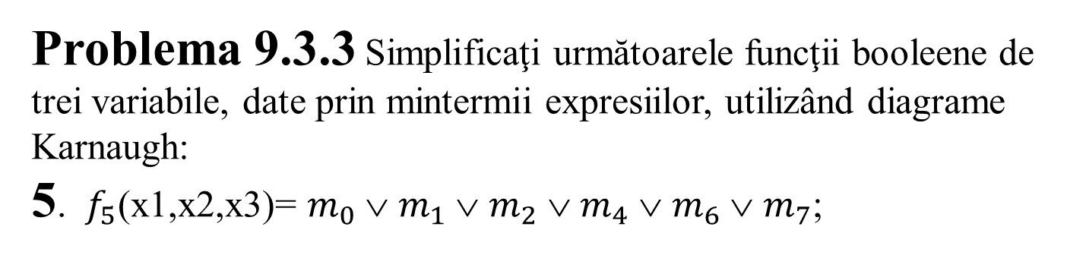
Problema 9.3.3 Simplificaţi următoarele funcţii booleene de trei variabile, date prin mintermii expresiilor, utilizând diagrame Karnaugh:
5. $f_{5}$(x1,x2,x3)= $m_{0}$ ∨ $m_{1}$ ∨ $m_{2}$ ∨ $m_{4}$ ∨ $m_{6}$ ∨ $m_{7}$;

Slide 2



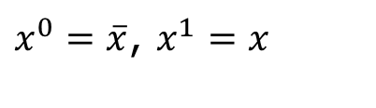




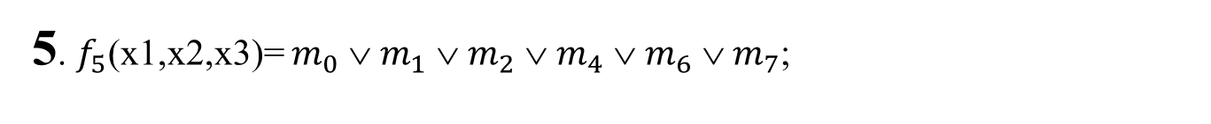












5. $f_{5}$(x1,x2,x3)= $m_{0}$ ∨ $m_{1}$ ∨ $m_{2}$ ∨ $m_{4}$ ∨ $m_{6}$ ∨ $m_{7}$;
$$x_{2}x_{3}$$ $$x_{1}$$ | 00 | 01 | 11 | 10
0 | $$m_{0}$$ | $$m_{1}$$ |  | $$m_{2}$$
1 | $$m_{4}$$ |  | $$m_{7}$$ | $$m_{6}$$
$m_{0}$=$m_{{\text{000}}_{(2)}}$=
${x_{1}^{}}^{0}∧ {x_{2}^{}}^{0}$ $∧$ ${x_{3}^{}}^{0}$=
$$\overline{x_{1}} \overline{x_{2}} \overline{x_{3}}$$
$x^{0}=\overline{x}$, $x^{1}=x$
$m_{1}$=$m_{{\text{001}}_{(2)}}$=
${x_{1}^{}}^{0}∧ {x_{2}^{}}^{0}$ $∧$ ${x_{3}^{}}^{1}$=
$$\overline{x_{1}} \overline{x_{2}}x_{3}$$
$m_{2}$=$m_{{\text{010}}_{(2)}}$=
${x_{1}^{}}^{0}∧ {x_{2}^{}}^{1}$ $∧$ ${x_{3}^{}}^{0}$=
$$\overline{x_{1}} x_{2}\overline{x_{3}}$$
$m_{4}$=$m_{{\text{100}}_{(2)}}$=
${x_{1}^{}}^{1}∧ {x_{2}^{}}^{0}$ $∧$ ${x_{3}^{}}^{0}$=
$$x_{1}\overline{x_{2}} \overline{x_{3}}$$
$m_{6}$=$m_{{\text{110}}_{(2)}}$=
${x_{1}^{}}^{1}∧ {x_{2}^{}}^{1}$ $∧$ ${x_{3}^{}}^{0}$=
$$x_{1}x_{2}\overline{x_{3}}$$
$m_{7}$=$m_{{\text{111}}_{(2)}}$=
${x_{1}^{}}^{1}∧ {x_{2}^{}}^{1}$ $∧$ ${x_{3}^{}}^{1}$=
$$x_{1}x_{2}x_{3}$$

Slide 3



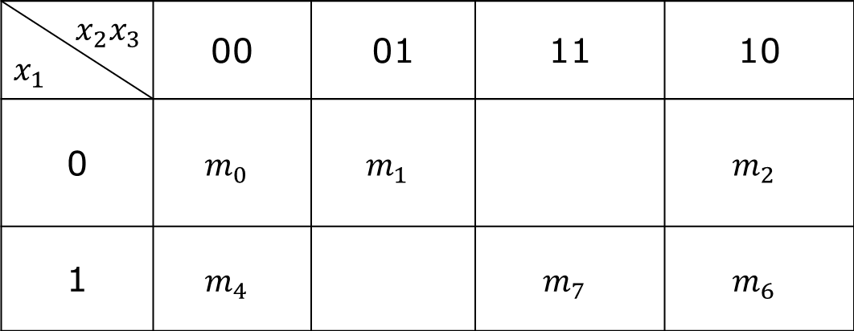










$$x_{2}x_{3}$$ $$x_{1}$$ | 00 | 01 | 11 | 10
0 | $$m_{0}$$ | $$m_{1}$$ |  | $$m_{2}$$
1 | $$m_{4}$$ |  | $$m_{7}$$ | $$m_{6}$$
Se grupeaza $2^{k}$ ,k $∈ℕ$ mintermi adiacenti ,k-cat mai mare:
$$\max_{1}=$$
$m_{0}∨m_{1}$= $\overline{x_{1}} \overline{x_{2}} \overline{x_{3}} ∨$ $\overline{x_{1}} \overline{x_{2}} x_{3}$=
$$\overline{x_{1}} \overline{x_{2}}$$
$$\max_{2}=$$
$m_{6}∨m_{7}$= $x_{1}x_{2}\overline{x_{3}}∨x_{1}x_{2}x_{3}$=
$$x_{1}x_{2}$$
$$\max_{3}=$$
$m_{0}∨m_{2}$ $∨m_{4}∨m_{6}$= $\overline{x_{1}} \overline{x_{2}} \overline{x_{3}} ∨\overline{x_{1}}x_{2}\overline{x_{3}}∨x_{1}\overline{x_{2}} \overline{x_{3}}∨x_{1}x_{2}\overline{x_{3}}$=
$$\overline{x_{3}}$$
M(f)=$\left\{\max_{1},\max_{2},\max_{3}\right\}$
M(f)$=$C(f)(Caz 1)
$f^{s}(x_{1,}x_{2},x_{3})$=
$\max_{1}∨\max_{2}∨\max_{3}$=
$$\overline{x_{1}} \overline{x_{2}} ∨x_{1}x_{2}∨\overline{x_{3}}$$

